Slide 1




UIAA TRACER STUDY DISSEMINATION
SYMPOSIUM
July 24th 2025
Samuel S. Waliggo (MPH), Solomon Kisembo & Miiro Michael
Notes:
🎙️ Speaker Note:
“Good morning, distinguished guests. Welcome to the dissemination of the first-ever Tracer Study of the Ireland Fellows Programme in Uganda.
Today, we reflect on three decades of transformation, leadership, and enduring partnerships.

Slide 2
IRELAND FELLOWSHIP PROGRAMME (IFP)-UIAA TRACER STUDY
1994 - 2024
“Celebrating 30 Years of Impact, Leadership, and Connection”
Notes:
🎙️ Speaker Note:
“Good morning, distinguished guests. Welcome to the dissemination of the first-ever Tracer Study of the Ireland Fellows Programme in Uganda.
Today, we reflect on three decades of transformation, leadership, and enduring partnerships.

Slide 3

KEY HIGHLIGHTS
Background of IFP & UIAA Tracer Study
01
Study Methodology
02
Alumni Voices of Impact & Documentary.
06
03
Alumni Career Outcomes & Impact
UIAA Engagement and Challenges, Recommendations & Future Pathways
05
04
Skills Development, Application and Development Contributions Outcomes

Slide 4

1974
IFP Globally launched
INTRODUCTION
AND
BACKGROUND
1994
IFP becomes cornerstone to IAD work in Uganda
The IFP Journey: From Global Impact to Local Leadership!
UIAA
founded
2012
Tracer Study was launched in January
2025
Notes:
1974 - IFP Globally launched to empower early and mid-career professionals to pursue postgraduate study in Ireland
Since 1994, the Ireland Fellows Programme (IFP) has served as a cornerstone of Irish Aid’s development work in Uganda- —Deputy Head of Mission at the Embassy of Ireland in Kampala. - Jill Clements.
In 2012, alumni founded the Uganda Irish Alumni Association (UIAA) — a network of leaders driving change across sectors.
With support from the Embassy of Ireland, the first-ever IFP Tracer Study was launched in January 2025, to measure impact and strengthen alumni engagement.

Slide 5
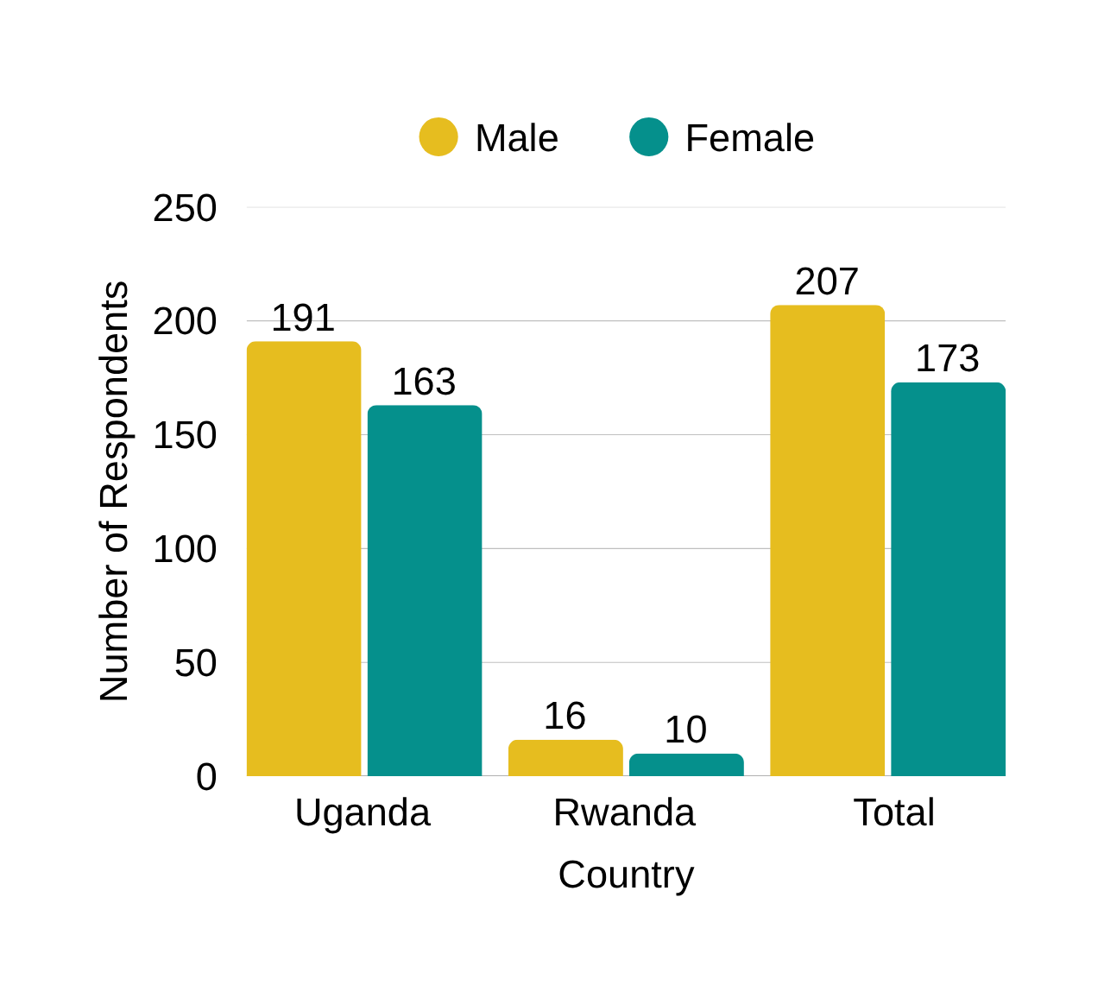
IFP FELLOWS TO-DATE
04
380 Fellows (207 males, 173 females) from Uganda & Rwanda
01
IFP Fellows 1994-2024
03
02
Notes:
To date, 380 Fellows (207 males, 173 females) from Uganda and Rwanda have completed one-year Master’s programs in Ireland or select East African universities.

Slide 6

🎯Objectives
Our Tracer Study is Not just about data ~ but stories, trajectories and lasting impact
Assess
Understand
Develop
long-term outcomes of IFP alumni (1994–2024)
alumni career trajectories and development contributions
strategies to strengthen UIAA engagement and inform future programming
Notes:
This study isn't just data—it’s also about stories, trajectories, and how alumni continue to build Uganda and beyond.
🎙️ Speaker Note:
“Our approach was participatory and inclusive—ensuring that every voice mattered, from the earliest fellows to the most recent graduates.”
6

Slide 7







EXPECTED OUTPUTS/DELIVERABLES
  UIAA Web based Alumni database
A platform for storing and managing alumni data and contact information
  Primary Output
  Full Tracer Study Report
  Video documentary
with actionable recommendations and learning Insights
A minimum 10 alumni success stories, experiences and impact
  Engagement strategy
Website: https://www.uiaanetwork.org
A plan to enhance alumni engagement and participation
Video: https://youtu.be/uwrVpS7RMec
Notes:
🎙️ Speaker Note:
“Good morning, distinguished guests. Welcome to the dissemination of the first-ever Tracer Study of the Ireland Fellows Programme in Uganda.
Today, we reflect on three decades of transformation, leadership, and enduring partnerships.

Slide 8

TS-METHODOLOGY OVERVIEW
  Collaborative Approach
  Data Collection Tools
Mixed-methods approach: Quanlitative & Quantitative methods
01
04
Quantitative: Online Structured Survey – Kobo Collect, NVivo, Excel, Python
Utilized: surveys, storytelling, and interviews
02
05
Qualitative (Transcribed using turboscribe)
Captured insights from 201 of 380 alumni (53% response rate)
03
06
10 KIIs with stakeholders, 3 Cohort-based FDG, 12 Narrative Stories, 1 Documentary.
Notes:
🔬 Collaborative Approach.
We adopted a mixed-methods approach—blending quantitative and qualitative techniques—guided by a census framework to ensure wide representation and depth understanding the IFP impact.
Through surveys, storytelling, and interviews, we captured insights from 201 of 380 alumni, achieving a 53% response rate (Table 1).
📋 Data Collection Tools.
Quantitative: Online Structured Survey – Kobo Collect, NVivo, Excel, Python
Qualitative (Transcribed using turboscribe): 10 Key Informant Interviews (KIIs) with Stakeholders.
3 Cohort-based FDG: Early (1994–2003), mid (2004–2013), recent (2014–2024)
12 Narrative Stories of Impact and One(1) Documentary.

Slide 9
Response Rate per Cohort
Cohort | Cohort Population | Respondents | Response Rate (%)
1994-2003: Early Years of The Program | 24 | 4 | 16.7
2004-2013 Middle Years of Program | 138 | 51 | 37.0
2014-2024: Recent Years of Program. | 200 | 133 | 66.5
2024: Active Cohort | 18 | 13 | 72.2
Total respondents (1994-2024) | 380 | 201 | 53.0
Recent cohort (2014–2024), demonstrated the highest response Rate.
Notes:
🎙️ Speaker Note:
The tracer survey recorded responses from 201 respondents out of a total 380 alumni, yielding an overall response rate of 53%. The most recent cohort (2014–2024) had the highest number of respondents, with 133 respondents and a strong response rate of 66.5%, followed by the 2024+ active cohort, which recorded the highest response rate (72.2%). This trend suggests that enhanced digital communication tools, improved alumni tracking systems, and stronger program follow-up mechanisms may have contributed to increased participation in recent years. This rate outperformed global tracer study benchmarks: i.e. World Bank. (2018). Tracer studies: A guide for practitioners. Washington, DC: World Bank. doi: 10.1596/978-1-4648-1084-8-Response rates was 23%.
8

Slide 10

Key Findings
and Results
Demographic characteristics
Notes:
9

Slide 11
Respondents by Country
 | No. of Respondents | No. of Respondents | No. of Respondents | Total Respondents
Cohort | Uganda | Uganda | Rwanda
Cohort | (Other Regions) | Karamoja Region
1994-2003: Early Years of The Program | 4 (100%) | 0 (0%) | 0 (0%) | 4 (100%)
2004-2013: Middle Years | 45 (88.2%) | 6 (11.8%) | 0 (0%) | 51 (100%)
2014-2024: Recent Years | 97 (72.9%) | 25 (18.8%) | 11 (8.3%) | 133 (100%)
2024: Active Fellows | 10 (76.9%) | 3 (23.1%) | 0 (0%) | 13 (100%)
Total | 156 (77.6%) | 34 (16.9%) | 11 (5.5%) | 201 (100%)
Notes:
🎙️ Speaker Note:
Ugandan alumni overwhelmingly dominated the survey, with 190 respondents (94.5%), highlighting the country’s strong representation in the program. Within Uganda, 34 fellows (16.9%) were from the Karamoja region, a historically marginalized area.
Beyond Uganda, 11 fellows (5.5%) were from Rwanda, all of whom belonged to the 2014–2024 cohort. This trend aligns with Irish Aid's extension of the program in Rwanda in 2016
10

Slide 12
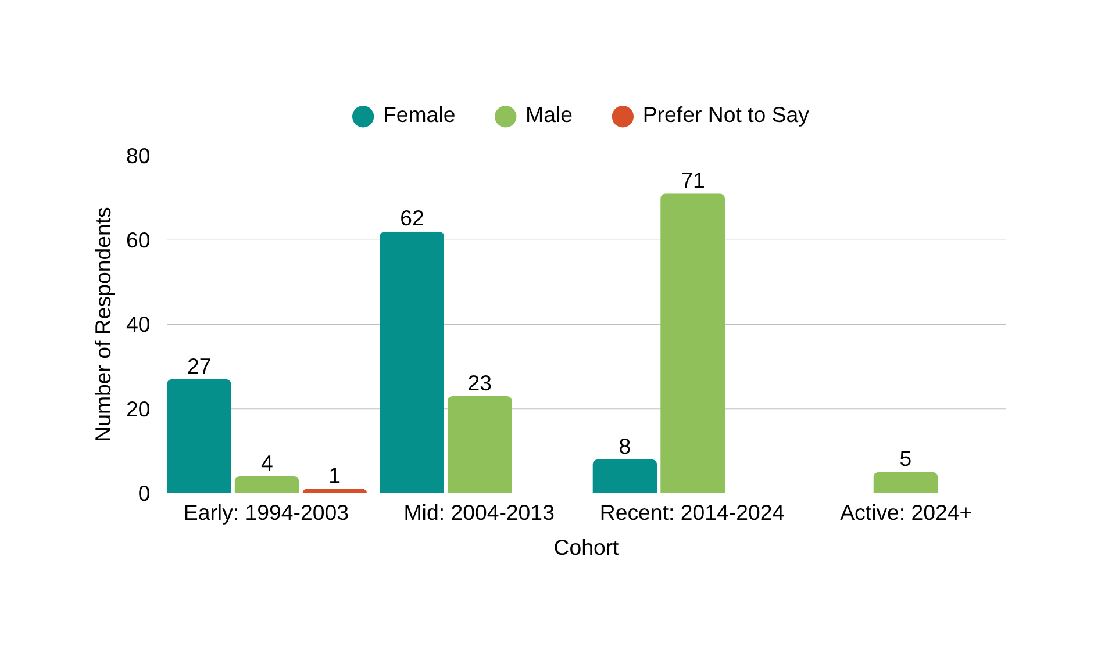
Respondents By Gender
Notes:
🎙️ Speaker Note:
Gender Distribution: Of the 201 respondents, 51.2% were male (103 fellows), 48.3% were female (97 fellows), and 0.5% (1 respondent) preferred not to disclose their gender (Table 2). This near-equal gender representation highlights the program’s strong commitment to gender inclusivity.
11

Slide 13
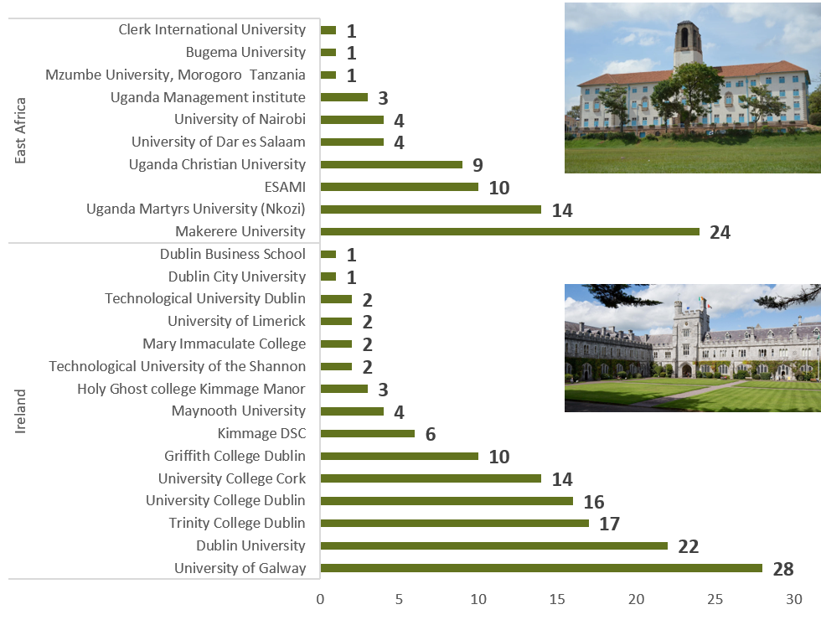
Preferred Academic Institutions
58.2% studied in Ireland; 41.8% in East Africa
  Top Irish universities: Galway, Trinity, UCD, UCC
  Top Ugandan institutions: Makerere, UMU, ESAMI
Notes:
🎙️ Speaker Note:
“These institutions have shaped the minds of leaders who now shape policy, systems, and communities.”
"From Galway to Makerere, the program bridged Irish and Ugandan academia. That connection fuels transformation."
12

Slide 14
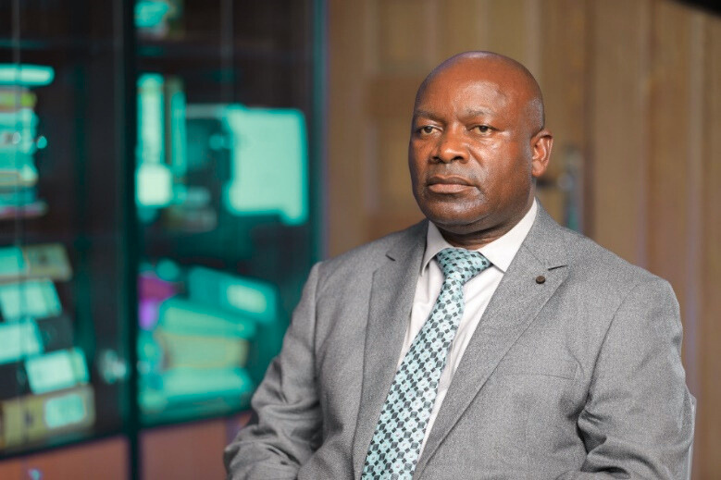
CAREER OUTCOMES AND IMPACT
04
01
97.9% of IFP fellows completed the Master’s program
03
95% reported improved work performance & Effectiveness Post IFP
“The IFP is like a master key—once you obtain it, it opens doors to endless opportunities, from Teacher to Commissioner for Basic Education!”
02
Dr. Chleophus Mugenyi (Fellow 2000–2001) Commissioner for Basic Education, Ministry of Education and Sports, Uganda.
Notes:
🎙️ Speaker Note:
“The IFP has been a launchpad for professional growth—equipping fellows to lead, influence, and innovate across Uganda and Rwanda.
“From technical contributors to strategic shapers—UIAA alumni are Uganda’s quiet revolutionaries.”
13

Slide 15
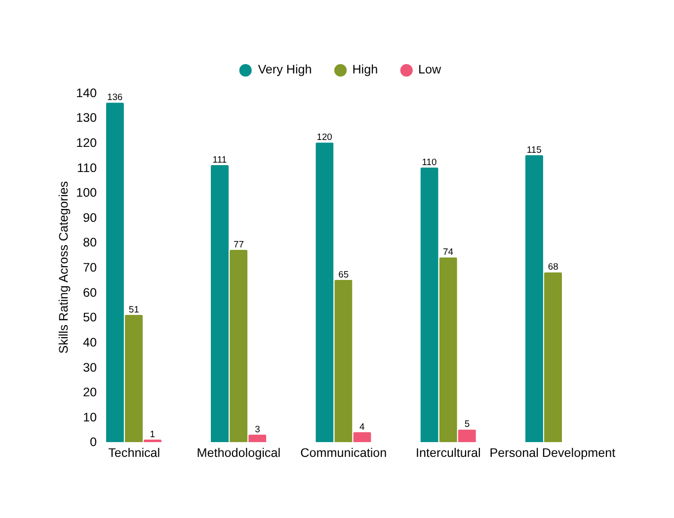
SKILLS DEVELOPMENT & APPLICATION
Over 90% of fellows rated acquired skills as 'Very High' or 'High' for work usefulness, underscoring the program’s significant career impact.
03
Notes:
🎙️ Speaker Note:
Over 90% of fellows rated the usefulness of acquired skills in their work as 'Very High' or 'High,' highlighting the program’s profound impact on their career development and Effectiveness.
Top skills: Technical, Communication, leadership, and intercultural fluency ranked highest.
Recent cohorts (2014-2024) reported smoother integration of acquired skills into workforce.
“These aren’t just academic gains—they’re practical tools that fellows are applying in real-time to solve real-world challenges.”
It is becoming increasingly easier for fellows to translate the knowledge and skills acquired through the Ireland Fellowship Program into their employment, with recent cohorts (2014-2024 experiencing smoother integration into the workforce compared to earlier cohorts (2004-2013, 2014-2024).
14

Slide 16
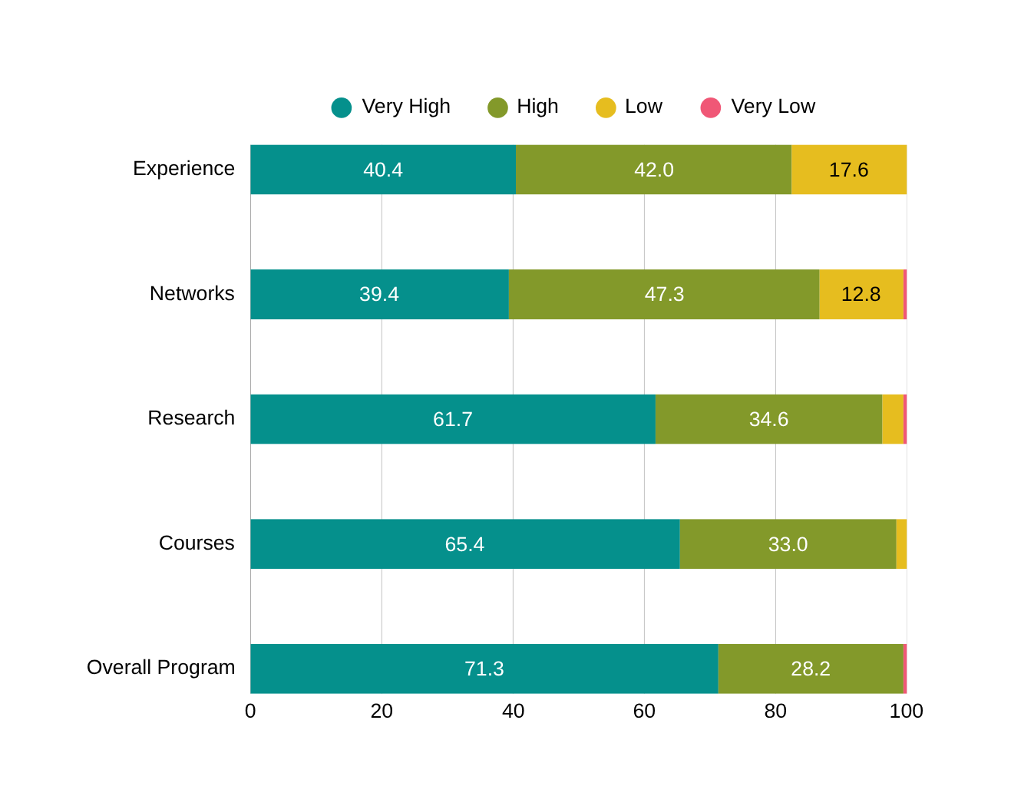
Usefulness of Acquired Skills in Work
04
Research, dynamic course content, networking, and rich international exposure in Ireland significantly shaped fellows’ professional trajectories. Structured mentorship and consistent engagement are essential for meaningful professional growth.
01
03
02
Notes:
🎙️ Speaker Note:
Overall Program Impact: A strong majority of fellows (71.3%) rated the overall program as "Very High" in usefulness, with an additional 28.2% marking it as "High." This underscores the program’s clear role in equipping participants with relevant skills and competencies for their careers.
These findings suggest a need to expand mentorship opportunities, enhance internship placements, and foster more consistent alumni engagement to support fellows in building meaningful professional relationships and practical exposure.
15

Slide 17
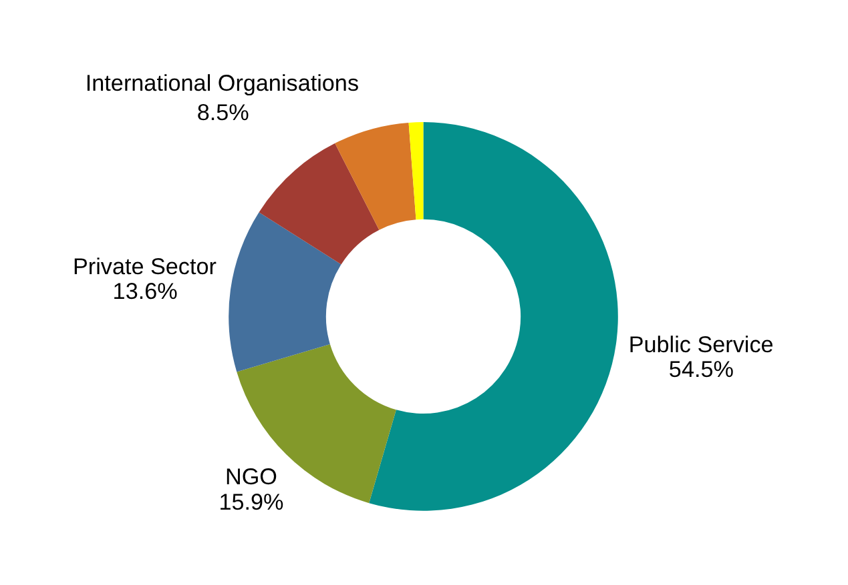
DEVELOPMENT CONTRIBUTION OUTCOMES
1. Employment Status
78.7% of fellows are employed in public service, NGOs, private sector, international organizations, academia, financial institutions, and other sectors.
03
Notes:
Perceived Link to Development: 73.4% reported that their work contributes significantly (75–100%) to national development outcomes-especially in Public services and policy spaces.
Residence Status: 86% work in their home countries show casing effective programme retention, whereas 14% explored international opportunities in Ireland.
Fellows influence policy, governance, education, and health and entrepreneurship.
“Fellows are not just advancing their careers—they’re shaping national priorities and delivering impact where it matters most.”
16

Slide 18
DEVELOPMENT CONTRIBUTION OUTCOMES
2. Perceived Link to Development
Perceived Link to Development: 73.4% reported that their work contributes significantly (75–100%) to national development outcomes-especially in Public services and policy spaces.
03
Notes:
Perceived Link to Development: 73.4% reported that their work contributes significantly (75–100%) to national development outcomes-especially in Public services and policy spaces.
Residence Status: 86% work in their home countries show casing effective programme retention, whereas 14% explored international opportunities in Ireland.
Fellows influence policy, governance, education, and health and entrepreneurship.
“Fellows are not just advancing their careers—they’re shaping national priorities and delivering impact where it matters most.”
16

Slide 19
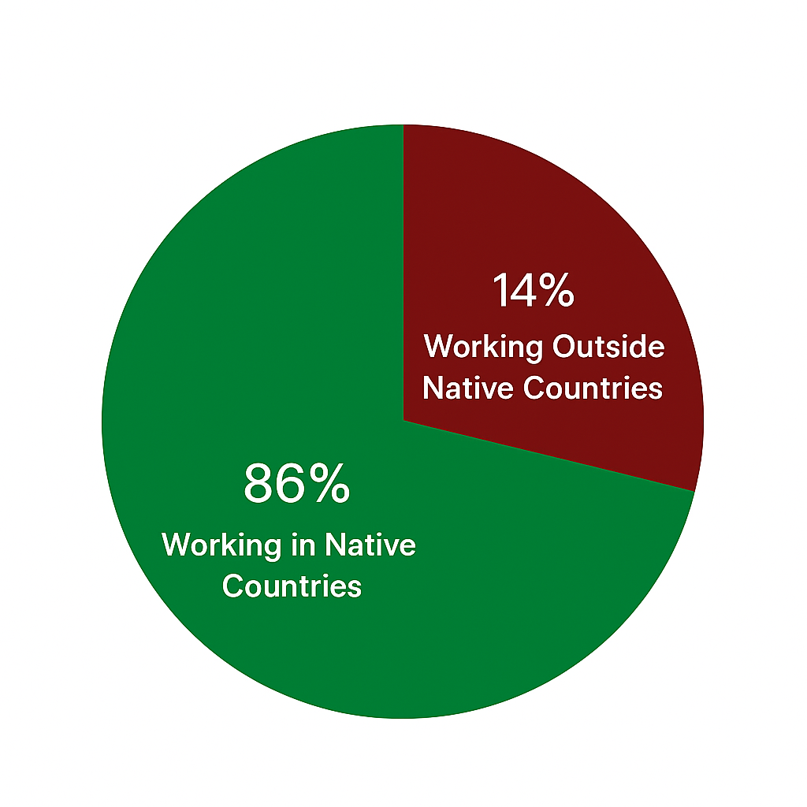
DEVELOPMENT CONTRIBUTION OUTCOMES
3. Residence Status.
86% work in their home countries show casing effective programme retention, whereas 14% explored international opportunities in Ireland.
Fellows influence policy, governance, education, and health and entrepreneurship
03
Notes:
Perceived Link to Development: 73.4% reported that their work contributes significantly (75–100%) to national development outcomes-especially in Public services and policy spaces.
Residence Status: 86% work in their home countries show casing effective programme retention, whereas 14% explored international opportunities in Ireland.
Fellows influence policy, governance, education, and health and entrepreneurship.
“Fellows are not just advancing their careers—they’re shaping national priorities and delivering impact where it matters most.”
16

Slide 20
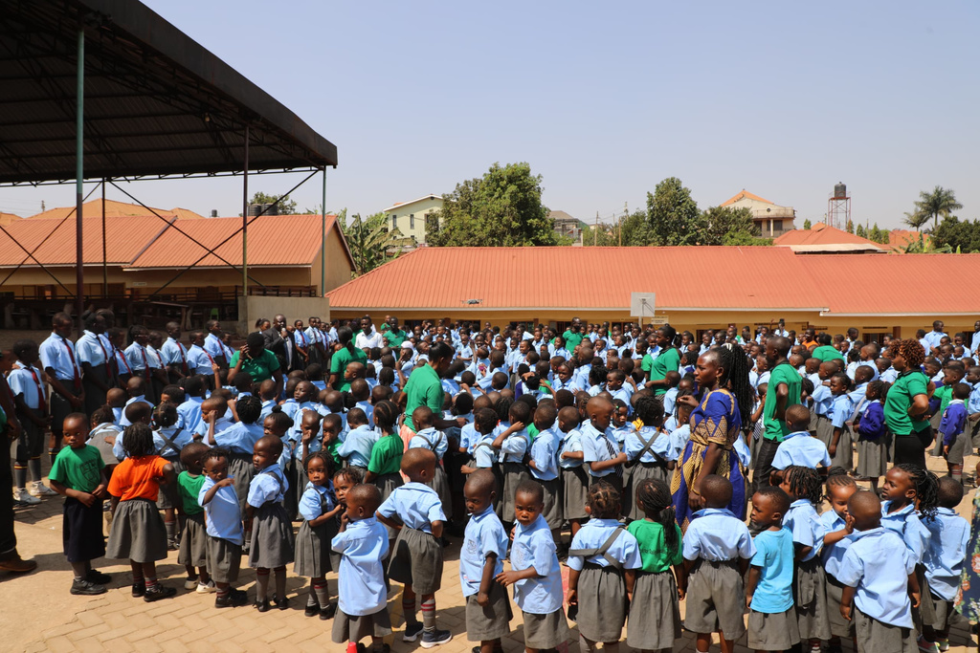
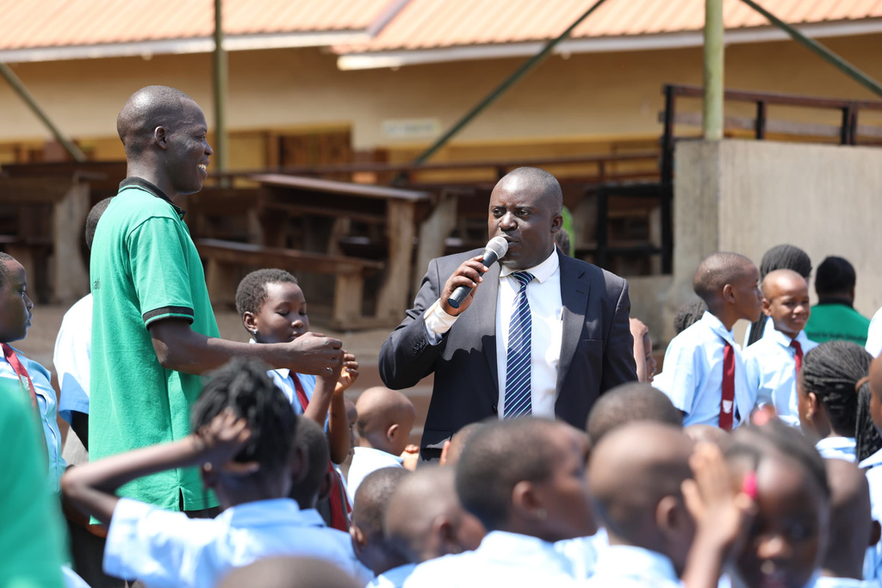
It’s about Networking and Maintaining Connections
“After My Master’s Degree in Global Health at Trinity College Dublin, I founded Vashon Day and Boarding Nursery and Primary Schools. Our School gives quality education to over 1,000 vulnerable children who can't afford the expensive schools in Metropolitan Kampala and creates over 500 jobs annually, making a significant impact in the community”
Henry Tumwebaze (Fellow 2011–2012)
Founder, Vashon Day and Boarding Nursery and Primary Schools; Founding President, UIAA

Slide 21
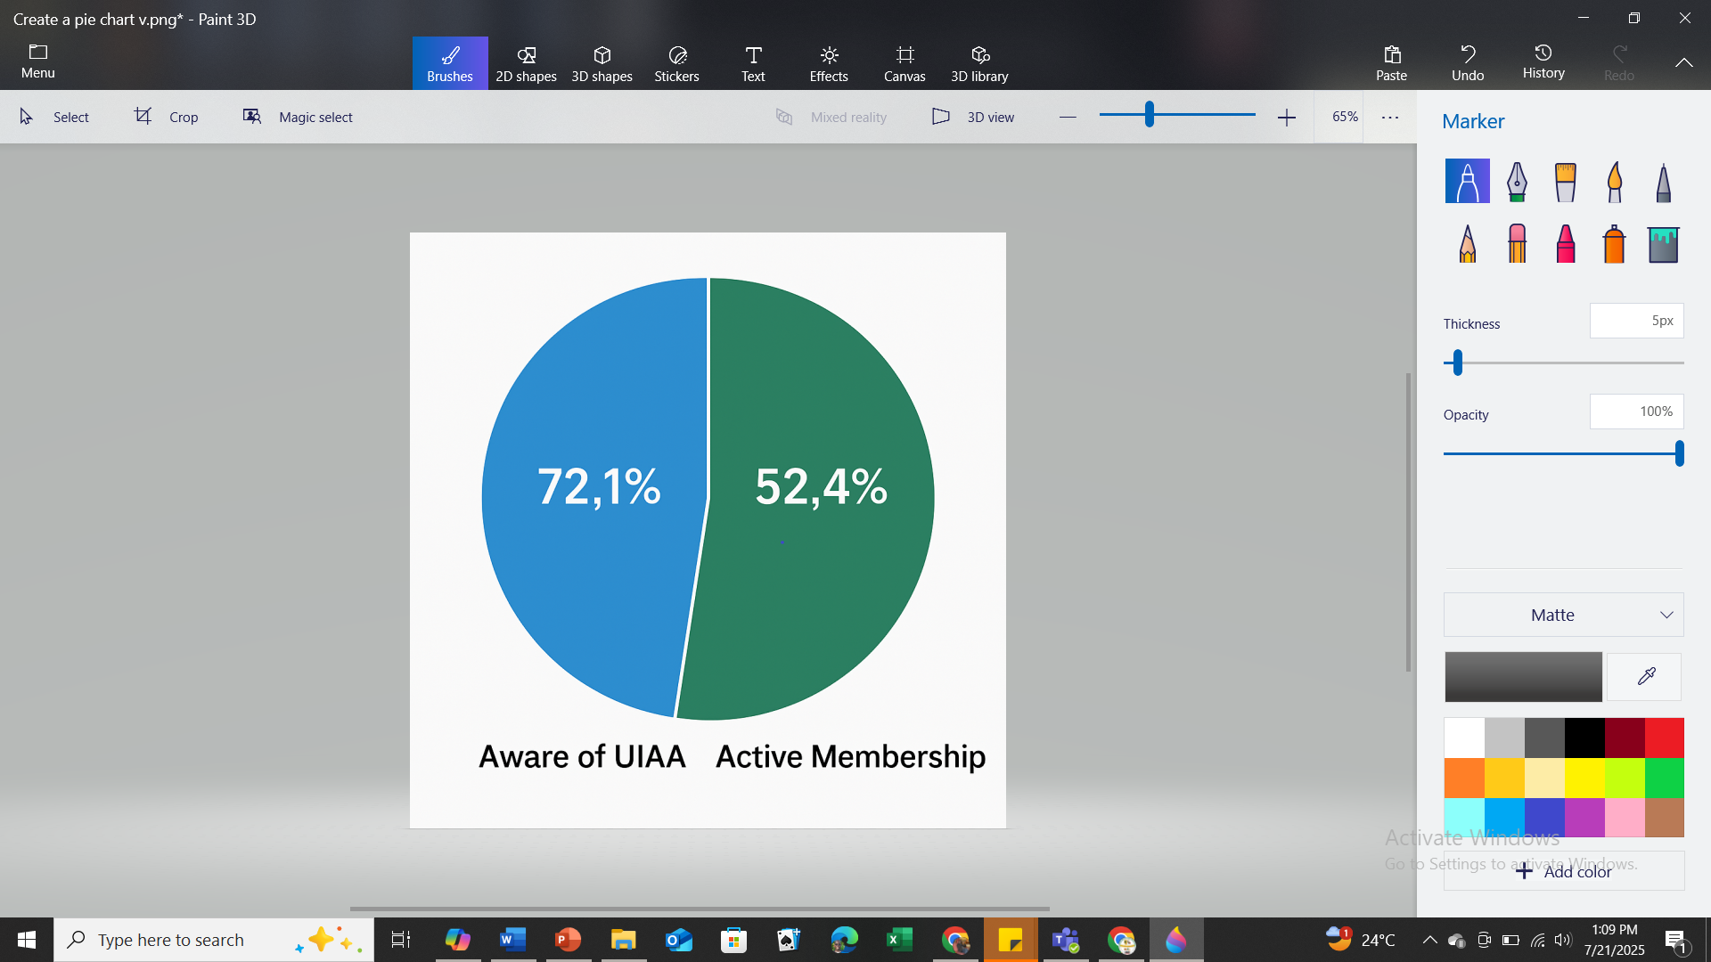
UIAA Engagement Snapshot
Meaningful engagement is average. Gender gap: 77.7% male vs. 67% female awareness. Lower engagement in Karamoja. UIAA relevance: 41.3% value, 30.8% dissatisfaction.
04
01
03
02
The network exists—but the threads are loose… We need to weave them tighter-Recent Fellows 2014–2024-FGD
Notes:
🎙️ Speaker Note:
“While awareness is strong, engagement remains uneven—especially among recent cohorts and female fellows. This is both a challenge and an opportunity.”
We must close gender and regional gaps.
19

Slide 22


01
📌 Structural Gaps — Unclear communication, limited incentives
Barriers to UIAA Engagement
— Insights from Fellows
📌 Fragmented Channels — WhatsApp-only communication, no professional platforms
02
03
📌 Cohort & Identity Disconnects — Strong university ties, weak UIAA unification
04
📌 Gender & Transitional Gaps — Female fellows underrepresented; recent cohorts face transition challenges
05
📌 Resource Constraints — Budget limits impact on outreach and programming

Slide 23


Cohort-Specific Challenges
& Opportunities
  Mid Cohort: 2004–2013
Relied on informal connections — now offers potential to formalize UIAA’s networking systems.
  Recent Cohort 2014–2024
  Early Cohort: 1994–2003
Faced employment and mental health transitions — calls for structured career and wellbeing support.
Lacked post-scholarship support — but senior fellows could play a vital role in mentorship.

Slide 24


Cohort Integration & Mentorship
Digital Platforms
Building a Stronger UIAA Alumni Ecosystem
04
01
03
Four Key Pillars
02
Inclusive Engagement
Structural Reforms

Slide 25


Alumni Voices for Engagement
We need active professional platforms e.g. LinkedIn, UIAA Portal that go beyond WhatsApp. – Female Fellow, 2017
This silo mentality kills the spirit of the association i.e. Strong university ties, weak UIAA unification – Male Fellow, 2012

Slide 26



Alumni Voices for Engagement
Our voices are missing in alumni programming.” – Female KII Respondent, 2022
Regional chapters & thematic events will track fellows left behind. – FDG Ealy Cohort 1994-2003
Structured mentorship and linking current fellows to early cohorts – Male Fellow, 1998

Slide 27






KEY ACTIONABLE
  RECOMMENDATIONS
  Institutionalize mentorship and career transition support.
  Expand gender and regional inclusion.
  1.
  5.
  Strengthen mental health and transition support to and from Ireland.
  Build professional digital alumni platform e.g.-LinkedIn, Website etc.
  6.
  2.
  Position UIAA as a strategic development partner with Irish Aid.
  Strengthen regional chapters and cohort-based engagement models.
  7.
  3.
  Conduct Regular tracer studies every 3–5 years for real time career progression & Impact tracking.
  Embed UIAA in national policy dialogue
  8.
  4.
Notes:
🎙️ Speaker Note:
“These recommendations are not abstract—they’re actionable. They reflect what alumni need to thrive and what the UIAA must become.”
Recognizing the importance of continuous support for alumni-strategies fostering stronger connections are crucial.
22

Slide 28
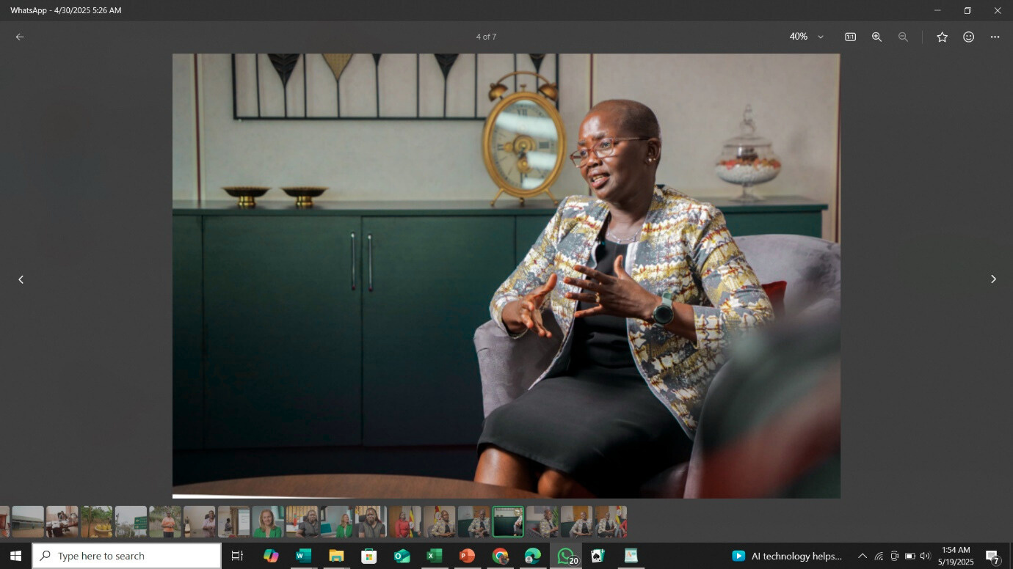
Alumni Voices of Transformation & Impact
04
01
We are not just alumni. We’re changemakers in Policy, Systems Reform & Governance.”– Lady Justice Jane Frances Abodo, (Fellow 2015–2016)
03
02
Notes:
🎙️ Speaker Note:
Alumni reflect on their experiences, sharing how the IFP profoundly influenced their personal and professional journeys. Their stories highlight the program's role in fostering skills, expanding networks, and building confidence, showcasing the lasting impact of the education and community support they received.
23

Slide 29
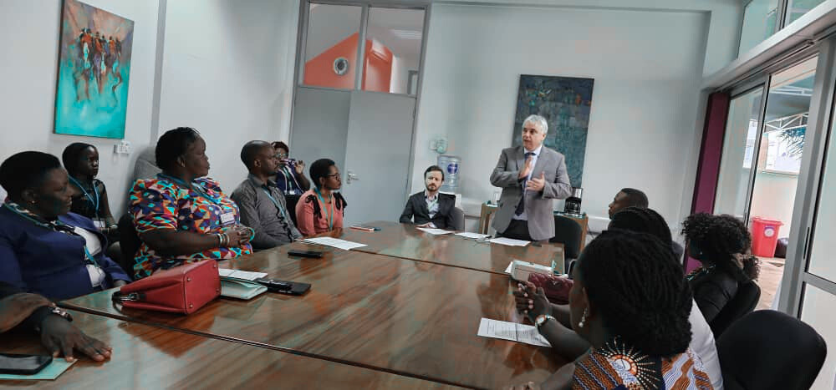
Acknowledgments
Deep thanks to the:
  Alumni participants
  Study Consultants
  UIAA Executive Committee
  ICOS
  Embassy of Ireland
  This journey belongs to all of us.
04
01
03
02
Notes:
🎙️ Speaker Note:
“To everyone who made this possible—thank you. Your commitment has laid the foundation for a stronger, more connected alumni community.”
24

Slide 30
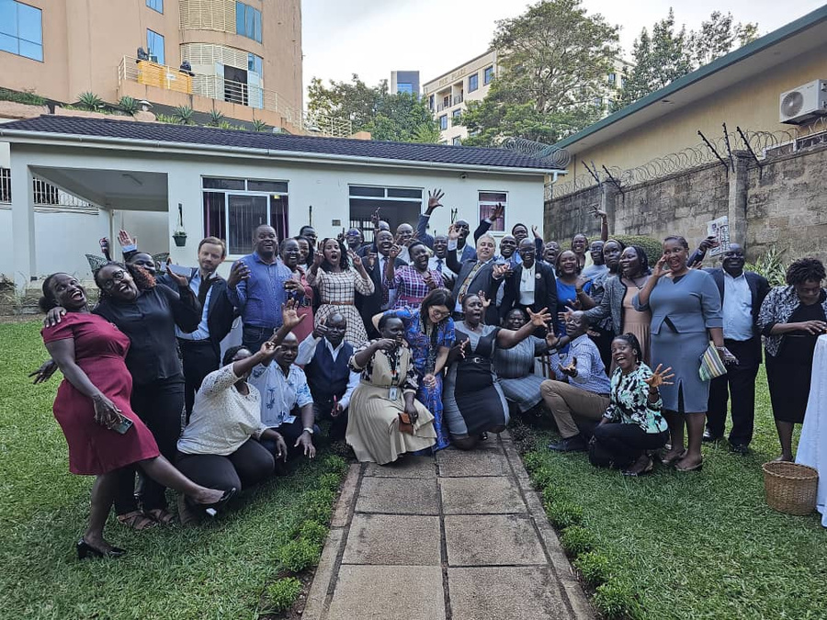



THANK YOU
+256 772 472524
admin@uiaanetwork.org
www.uiaanetwork.org
Notes:
🎙️ Speaker Note:
“Let’s continue to walk together—with humility, with courage, and with purpose. Thank you.”
25

